Slide 1
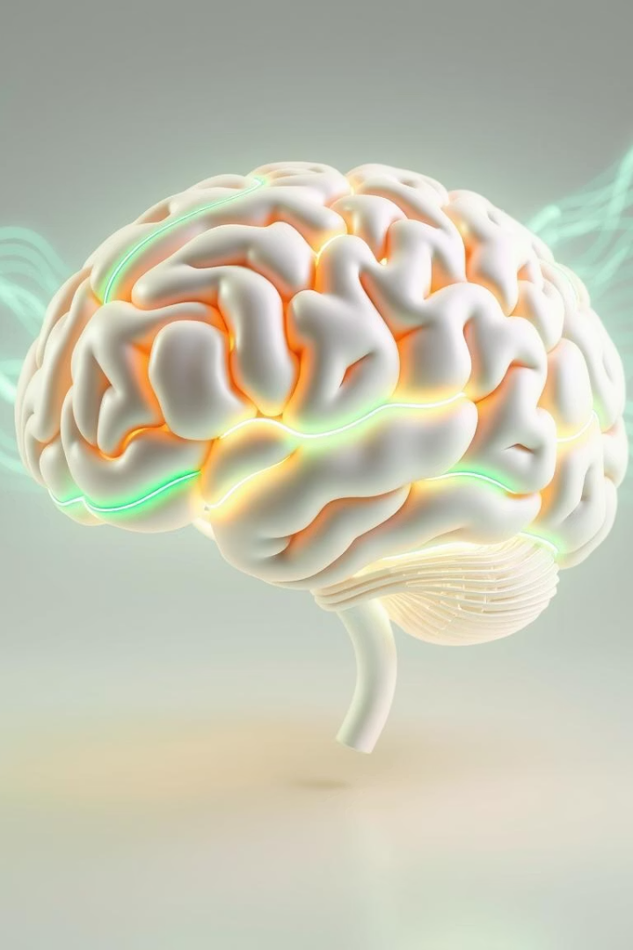
Efficient Deep Learning Models For Alzheimer’s Stage Detection Using MRI Images
Neurodegenerative diseases, particularly Alzheimer's disease, pose a significant public health challenge due to their increasing prevalence and lack of effective treatments. This presentation explores the application of efficient deep learning models for the classification of neurodegenerative diseases using MRI images.

Slide 2
Team Members
Fariha Zaman
Nowrin Sanjana
Department of Computer Science and Engineering
Department of Computer Science and Engineering
BRAC University, Dhaka, Bangladesh
BRAC University, Dhaka, Bangladesh
fariha.zaman1@g.bracu.ac.bd
nowrin.sanjana@g.bracu.ac.bd
Ayasha Islam
Ahanaf Abid Sazid
Department of Computer Science and Engineering
Department of Computer Science and Engineering
BRAC University, Dhaka, Bangladesh
BRAC University, Dhaka, Bangladesh
ayasha.islam@g.bracu.ac.bd
ahanaf.abid.sazid@g.bracu.ac.bd

Slide 3
The Challenge of Neurodegenerative Diseases
Rising Prevalence
Early Diagnosis is Key
Neurodegenerative diseases, such as Alzheimer's, are on the rise globally, affecting millions of people and placing a heavy burden on healthcare systems and families.
Early detection is crucial for slowing the progression of these diseases and potentially improving patient outcomes. However, subtle and gradual changes in symptoms often lead to delays in diagnosis.

Slide 4

Deep Learning as a Solution
Leveraging MRI Data
Advanced CNNs
Magnetic resonance imaging (MRI) provides detailed anatomical information about the brain, offering a powerful tool for detecting neurodegenerative changes.
Convolutional neural networks (CNNs) are particularly adept at analyzing images and can be trained to identify subtle patterns indicative of neurodegenerative diseases.

Slide 5




Model Architectures: A Comparison
VGG16
ResNet50
EfficientNetB0
A classic CNN known for its simplicity and depth. Effective for basic feature extraction but may struggle with subtle changes associated with early-stage dementia.
A deeper architecture with residual connections, enabling more complex feature learning, potentially more computationally intensive.
A lightweight and highly optimized model that balances depth, width, and resolution, offering computational efficiency and high accuracy.

Slide 6
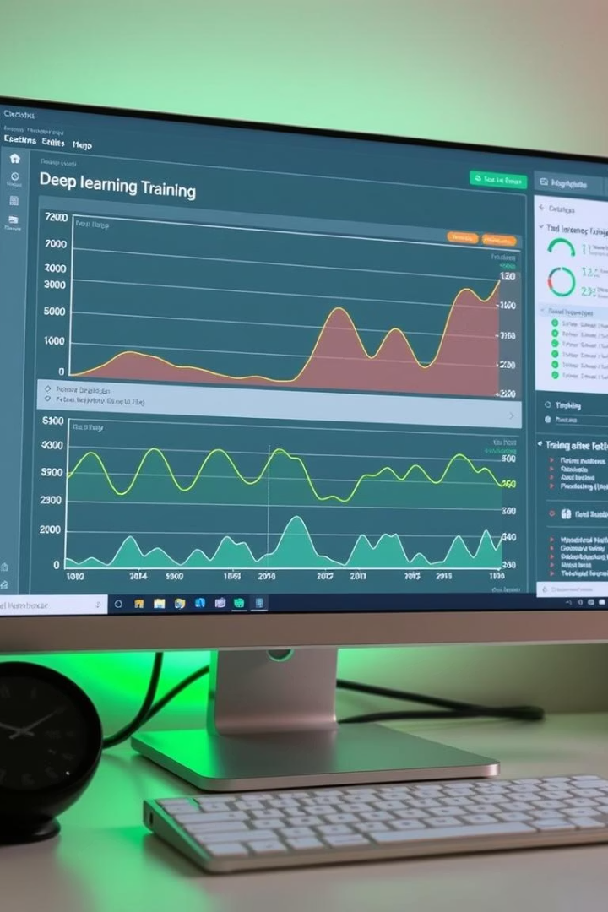
Training and Evaluation
1
Dataset
The study utilized a large-scale dataset from Kaggle of approximately 44,000 MRI images categorized into four classes based on Alzheimer's disease severity.
2
Training Procedure
Models were trained using a variety of techniques, including resizing to 224x224, data augmentation like rotation, flipping, and zooming, normalization and.
Batch Size: 32
Epochs: 25
Loss Function: Categorical Crossentropy
Optimizer: Adam
3
Performance Evaluation
Models were evaluated on their ability to classify Alzheimer's disease severity with accuracy, precision, recall and F1 score

Slide 7

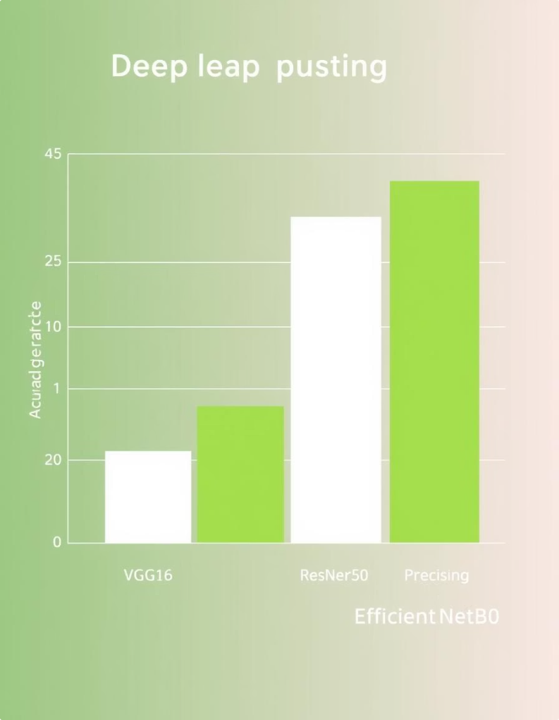
Model Performance: A Detailed Look
78%
95.5%
VGG16
ResNet50
Achieved an overall accuracy of 78%, demonstrating the model's ability to classify Alzheimer's disease, but with potential limitations in identifying subtle changes associated with early stages.
Outperformed VGG16 with an accuracy of 95.5%, showcasing the benefits of deeper architecture for capturing more complex patterns in MRI data.
95.6%
EfficientNetB0
Achieved the highest accuracy of 95.6%, highlighting its efficiency and effectiveness in handling large-scale medical imaging datasets.

Slide 8
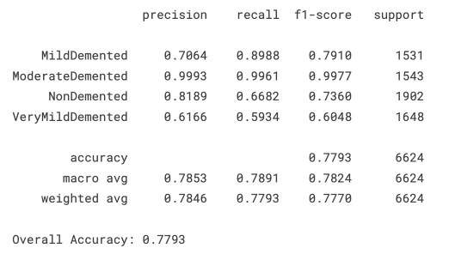
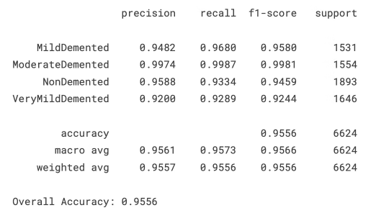
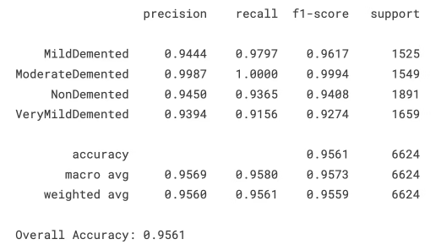
Precision, Recall, F1 Score
VGG16
ResNet50
EfficientNetB0

Slide 9
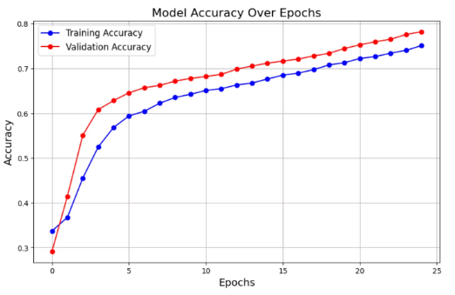
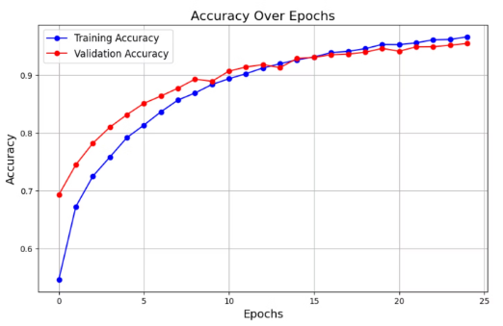
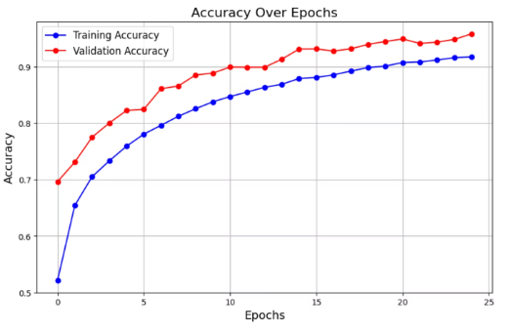
Accuracy Graph
VGG16
ResNet50
EfficientNetB0

Slide 10
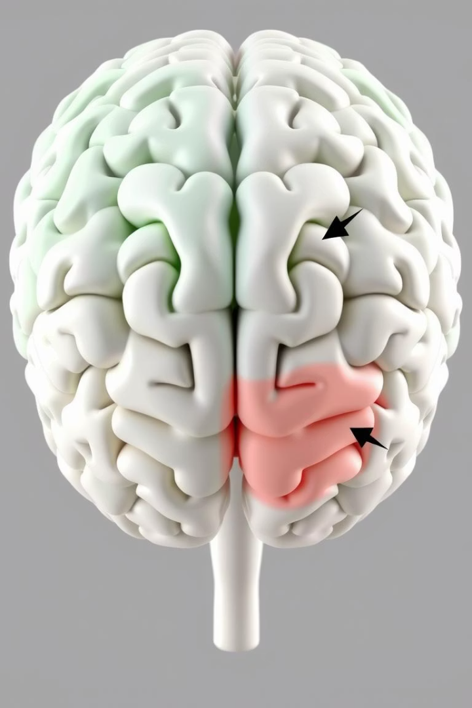



Key Findings and Insights
EfficientNetB0
Demonstrated superior performance, suggesting its potential for use in real-world clinical settings for early and accurate detection of Alzheimer's disease.
Transfer Learning
The study highlights the success of transfer learning, where pre-trained models are fine-tuned for specific medical imaging applications, reducing the need for extensive training data.
Data Imbalance
Data imbalance, where certain classes are underrepresented, remains a challenge. Future research should address this issue to improve model accuracy and generalizability.

Slide 11



Future Directions
Ensemble Methods
1
Combining multiple models to improve prediction accuracy and robustness.
Data Augmentation
2
Developing advanced data augmentation techniques to address data imbalance and improve model generalization.
Feature Extraction
3
Exploring innovative feature extraction techniques to better capture the subtle changes associated with neurodegenerative diseases.

Slide 12
Conclusion
Potential Impact
1
This study provides valuable insights into the potential of deep learning for early and accurate detection of neurodegenerative diseases, paving the way for more effective treatments and improved patient outcomes.
Continued Research
2
Further research is essential to address remaining challenges and develop even more robust and reliable deep learning models for neurodegenerative disease diagnosis.
Hope for the Future
3
These advancements offer hope for improving the lives of individuals affected by neurodegenerative diseases and their families.

Slide 13
References
Yellu, R. R., Kukalakunta, Y., & Thunki, P. (2024, May 1). Deep Learning-Assisted Diagnosis of Alzheimer’s Disease from Brain Imaging Data. https://healthsciencepub.com/index.php/jaihm/article/view/18
Li, S., Qu, H., Dong, X., Dang, B., Zang, H., & Gong, Y. (2024, March 24). Leveraging Deep Learning and XCeption Architecture for High-Accuracy MRI classification in Alzheimer diagnosis. arXiv.org. https://arxiv.org/abs/2403.16212
Pradhan, N., Sagar, S., & Singh, A. S. (2023). Analysis of MRI image data for Alzheimer disease detection using deep learning techniques. Multimedia Tools and Applications, 83(6), 17729–17752. https://doi.org/10.1007/s11042-023-16256-2
Hashmi, A., & Barukab, O. (2023). Dementia classification using deep reinforcement learning for early diagnosis. Applied Sciences, 13(3), 1464. https://doi.org/10.3390/app13031464
Helaly, H. A., Badawy, M., & Haikal, A. Y. (2021). Deep learning approach for early detection of Alzheimer’s disease. Cognitive Computation, 14(5), 1711–1727. https://doi.org/10.1007/s12559-021-09946-2
Sisodia, P. S., Ameta, G. K., Kumar, Y., & Chaplot, N. (2023). A review of deep transfer learning Approaches for Class-Wise prediction of Alzheimer’s Disease using MRI images. Archives of Computational Methods in Engineering, 30(4), 2409–2429. https://doi.org/10.1007/s11831-022-09870-0
Hazarika, R.A.; Maji, A.K.; Kandar, D.; Jasinska, E.; Krejci, P.; Leonowicz, Z.; Jasinski, M. An Approach for Classification of Alzheimer’s Disease Using Deep Neural Network and Brain Magnetic Resonance Imaging (MRI). Electronics 2023, 12, 676. https://doi.org/ 10.3390/electronics12030676
DEMNET: A deep learning model for early diagnosis of Alzheimer diseases and dementia from MR images. (2021). IEEE Journals & Magazine | IEEE Xplore. https://ieeexplore.ieee.org/abstract/document/9459692/
Altinkaya, E., Polat, K., & Barakli, B. (2020). Detection of Alzheimer’s Disease and Dementia States Based on Deep Learning from MRI Images: A Comprehensive Review. Journal of the Institute of Electronics and Computer, 1(1), 39–53. https://doi.org/10.33969/jiec.2019.11005
Warren, S. L., & Moustafa, A. A. (2022). Functional magnetic resonance imaging, deep learning, and Alzheimer’s disease: A systematic review. Journal of Neuroimaging, 33(1), 5–18. https://doi.org/10.1111/jon.13063

